Slide 1


Bhavana Sharma
(Roll Number - 16010122183)
Tejaswini Shet
( Roll Number - 16010122187)
Vedanti Shukla
( Roll Number - 16010122191 )
Social-Engineer Toolkit (SET)

Slide 2


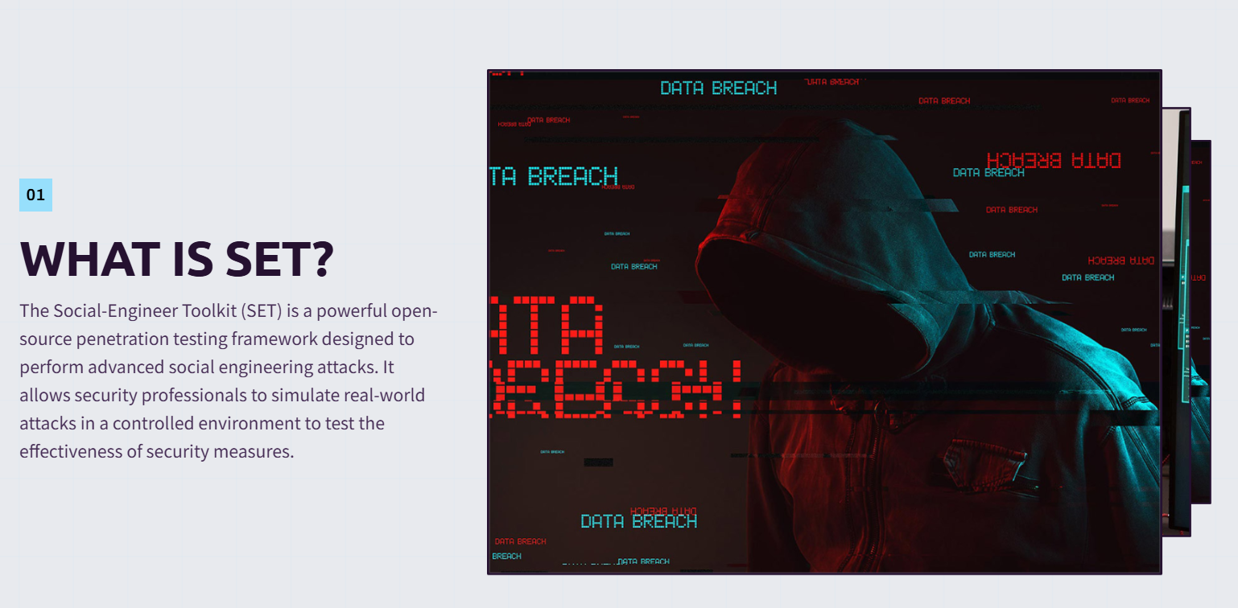

Slide 3

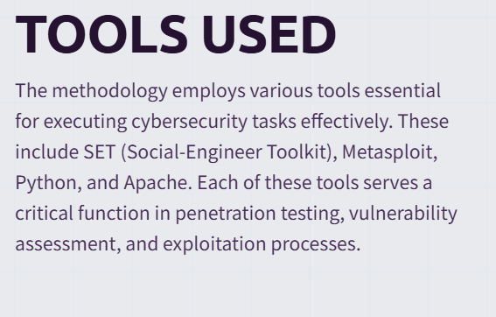

Slide 4
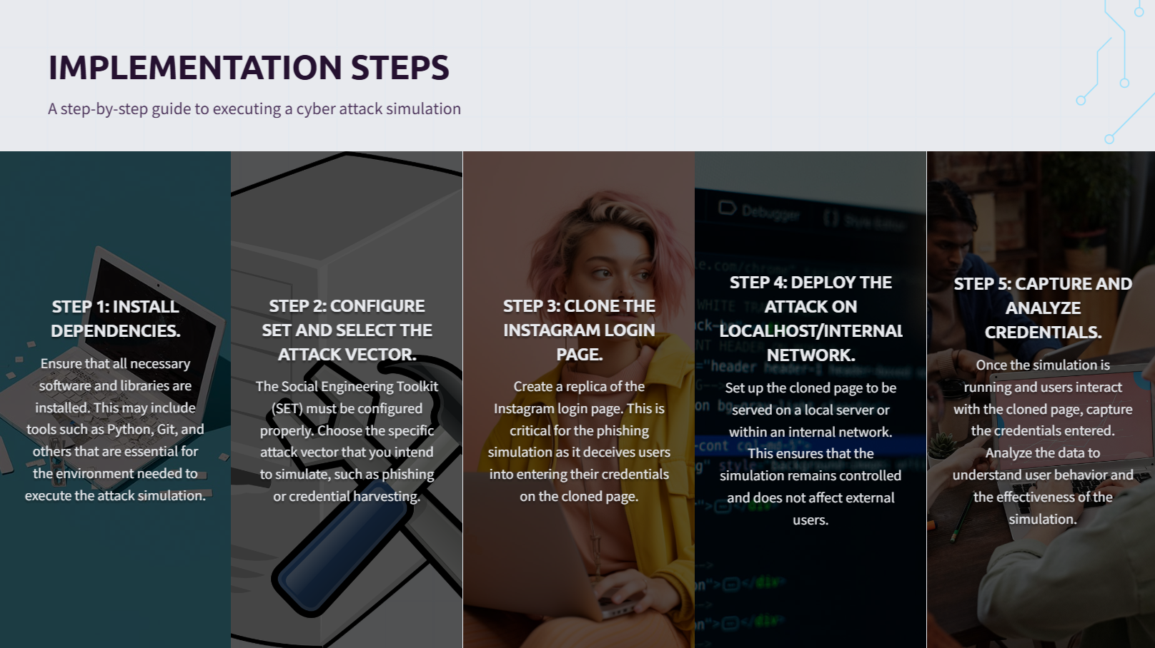

Slide 5

Results
The attack successfully cloned the Instagram login page, making it indistinguishable from the real one.
User-entered credentials were logged in real-time in the harvester log file.
The experiment showcased how easy it is for cybercriminals to trick unsuspecting users into revealing sensitive information.
The success rate of the attack depends on how well the phishing page is delivered to potential victims.

Slide 6
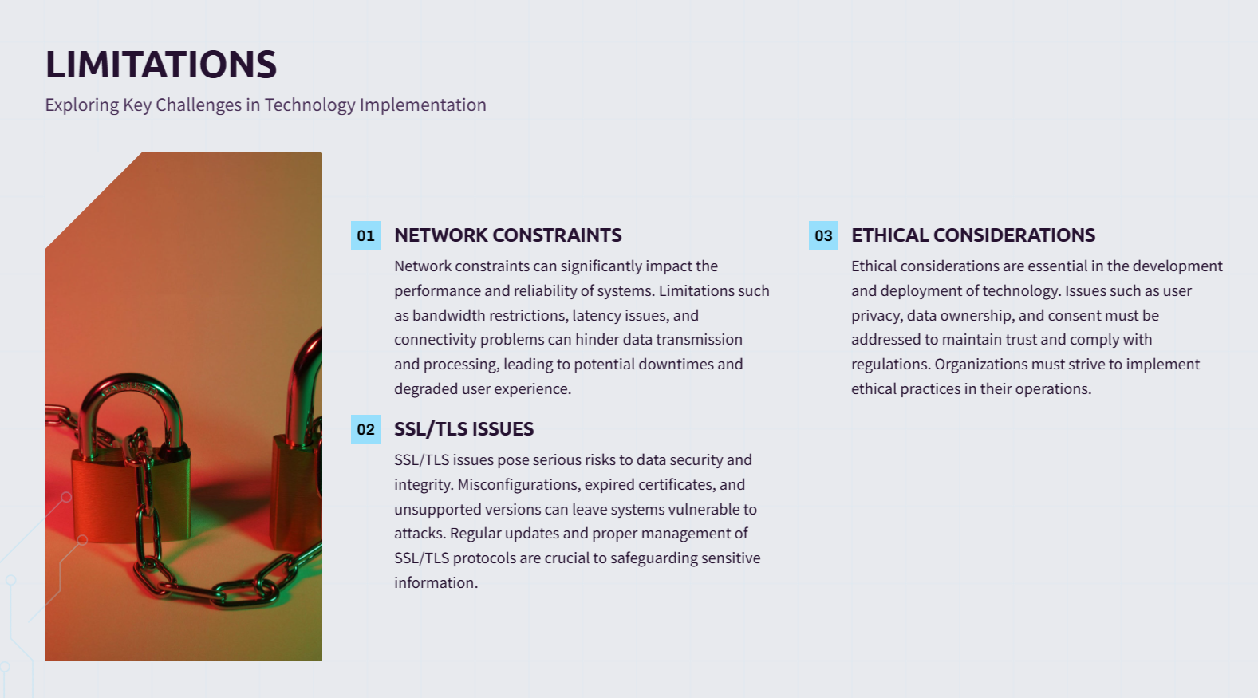

Slide 7
Conclusion
Credential harvesting is a major cybersecurity threat where attackers exploit user trust to steal sensitive information.
SET’s Site Cloner effectively replicates login pages, demonstrating how phishing attacks work.
Two-Factor Authentication (2FA) is crucial in preventing unauthorized access even if credentials are compromised.
Phishing awareness training is necessary to help users recognize and avoid fraudulent websites.
Secure login mechanisms like password managers, login alerts, and AI-driven phishing detection should be implemented.
Ethical hackers use this method to test security systems, helping organizations strengthen their defenses.
Continuous adaptation to evolving threats is essential to safeguard users and systems from credential theft.

Slide 8
References
[1] D. Kennedy, "The Social-Engineer Toolkit (SET): Automating Social Engineering Attacks," Black Hat, 2018.
[2] A. Kumar, "Phishing Techniques and Countermeasures in Cybersecurity," IEEE Transactions on Information Forensics, vol. 12, no. 3, pp. 456-468, 2021.
[3] Metasploit Documentation, "Metasploit Framework Usage Guide," 2023. Available: https://docs.metasploit.com
[4] Offensive Security, "SET Toolkit Documentation," 2023. Available: https://www.trustedsec.com
[5] C. Hadnagy, "Social Engineering: The Art of Human Hacking," Wiley, 2018.

Slide 9




